Slide 1
Class 10: Classification 1
MGSC 310
Ben Labaschin

Slide 2
Class 10: Outline
Why not regression for classification?
To the code!
Logistic Function
Estimating Logistic Regressions in R
Classification Lab
Log Odds Ratio

Slide 3
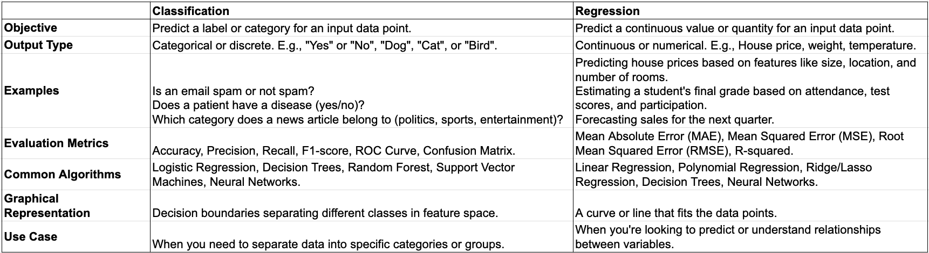
Difference Between Classification & Regression

Slide 4
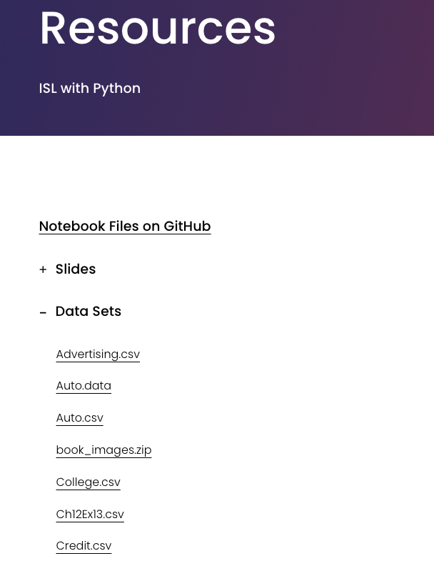
Credit Card Default Dataset
Link to Datasets

Slide 5
Trying Regression on Binary Data…
Link to the code!

Slide 6
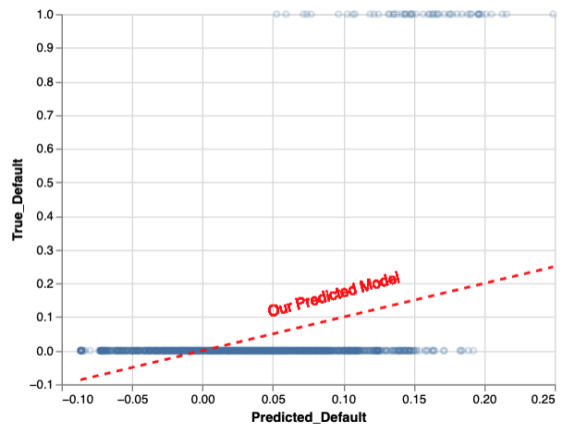
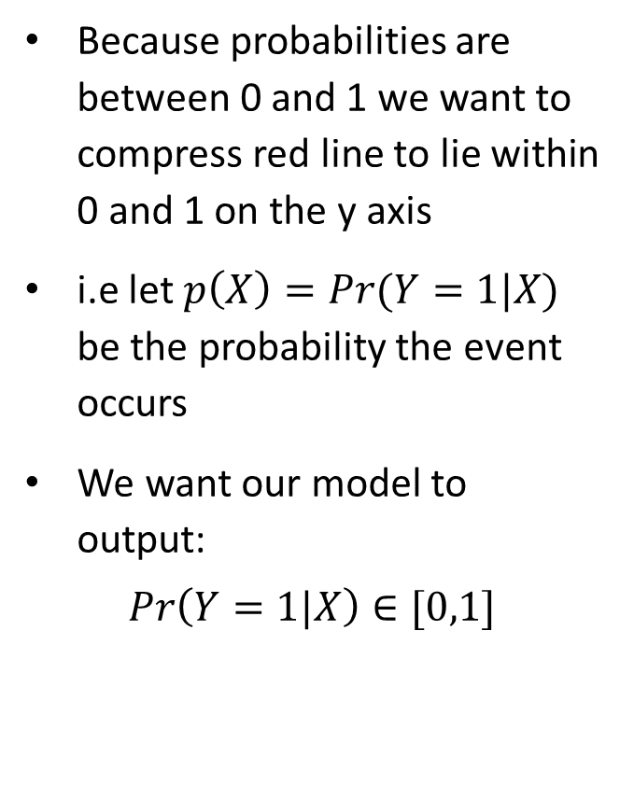
One Way to Improve the Earlier Model: Limit Probability of Default to Be Between 0 and 1

Slide 7
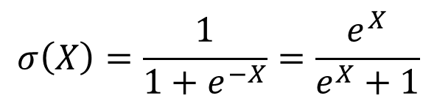
What is The Logistic/Sigmoid Function
The logistic regression function takes inputs X and transforms it between 0 and 1
1
The its function is defined as
0.5
0
0
X

Slide 8
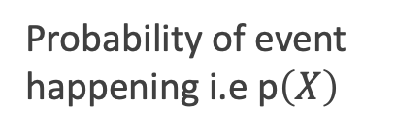
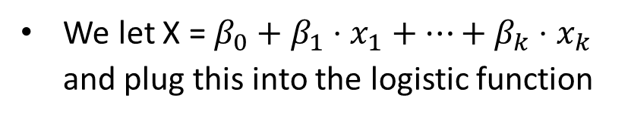

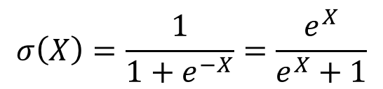
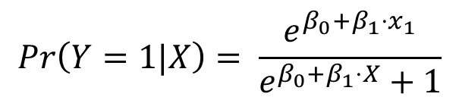
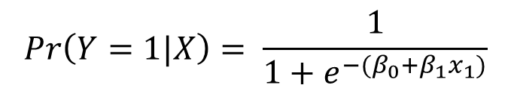

Using the Logistic/Sigmoid Function to Generate Probabilities
How do we generate probabilities from this function?
1
0.5
0
0
This is equivalent mathematically! I promise. Work it out on pen and paper if you don’t believe me

Slide 9
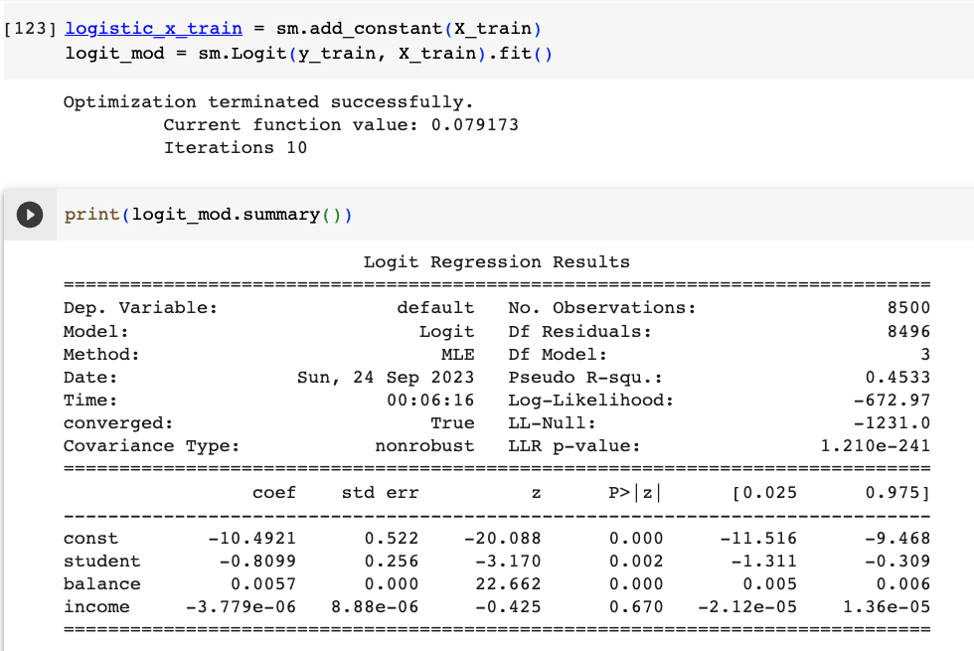
Estimating Logit Models Using Statsmodels
Estimate logistic regression using the “Logit” function in Python
Everything else is the same.
Note the slightly “improved” model.

Slide 10

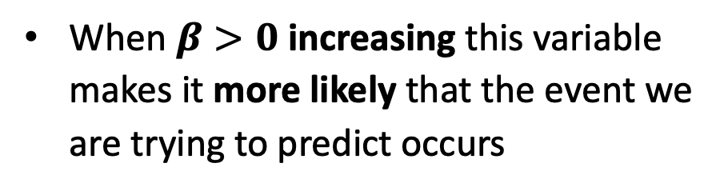
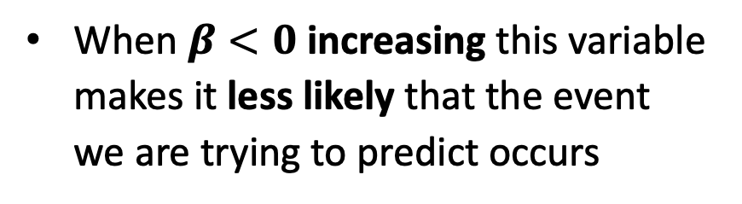
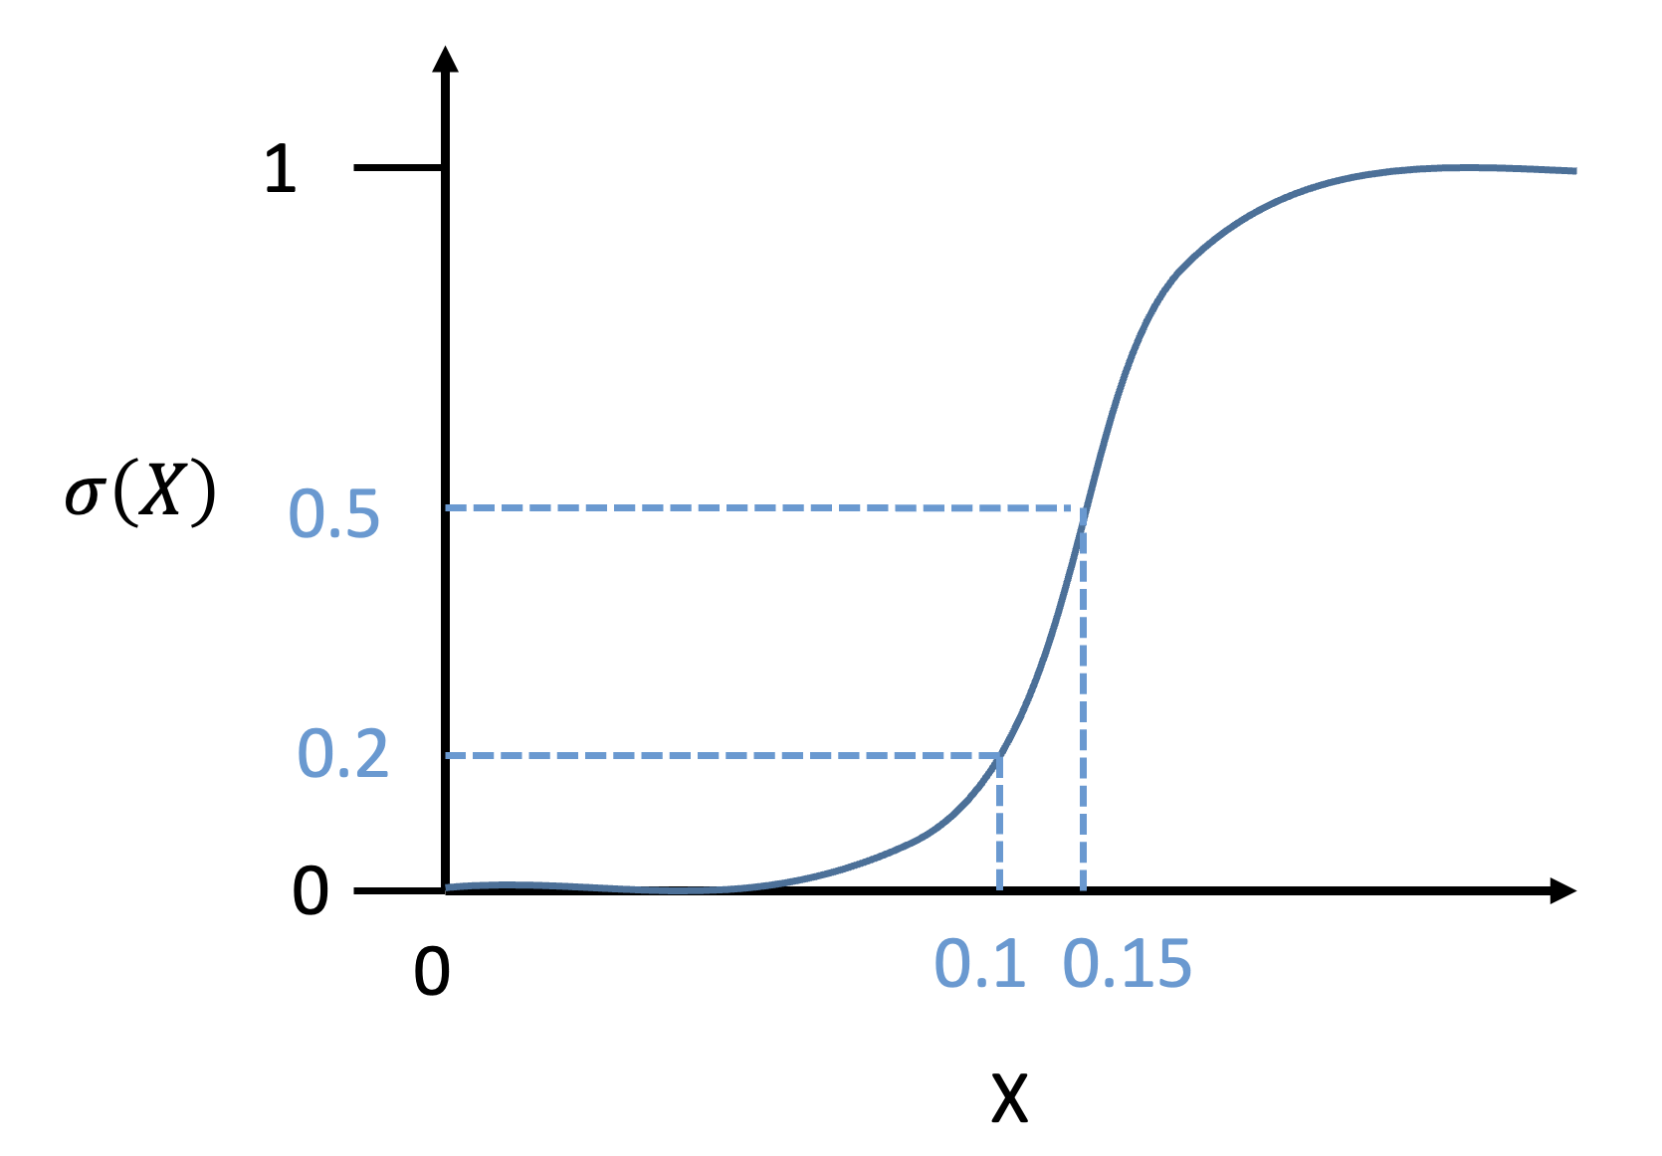
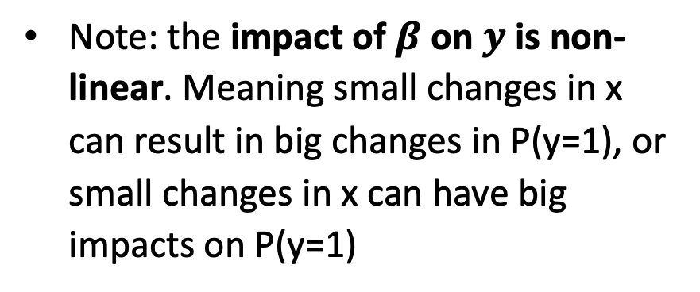
What do the coefficients tell us?

Slide 11

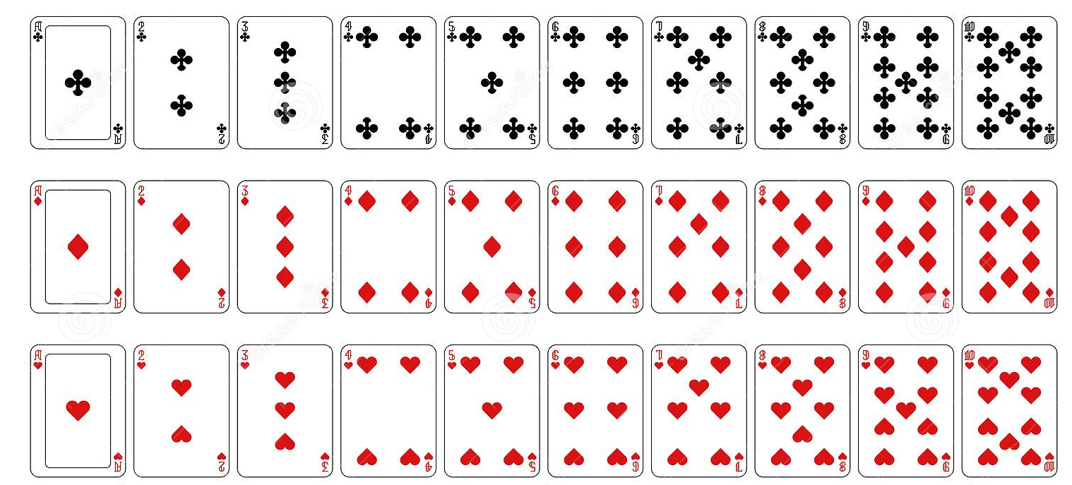
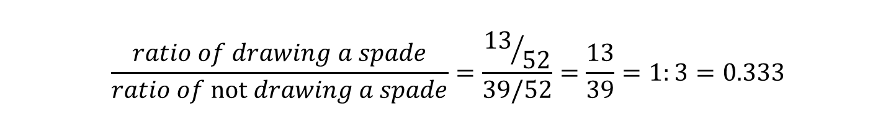
What is Logit? Introducing the “Odds Ratio”
The outcome variable in a logistic regression is the log of the “odds ratio” (OR)
In a deck of 52 cards there are 13 spades
The probability of randomly drawing a spade is 13/52 = 25%
The probability of not drawing a spade is 39/52 = 75%
Therefore the odds of drawing a spade vs not drawing a spade is
Log odds ratio is just log(0.333) = -0.4771…

Slide 12
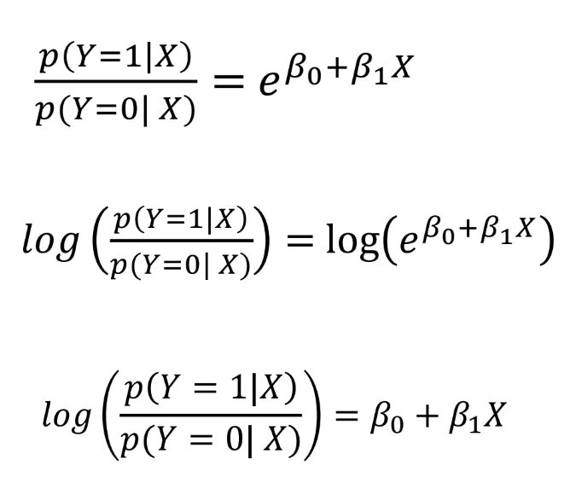
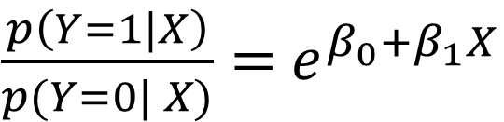
Logit Models Model the Outcome As a Log Odds Ratio
The outcome variable (Y) for a logistic regression is the log odds ratio
Log odds ratio is a linear expression of the X-variable’s impact in a nonlinear manner
All logistic coefficients can be interpreted as that variable’s impact on log odds ratio

Slide 13
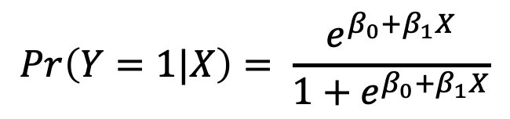

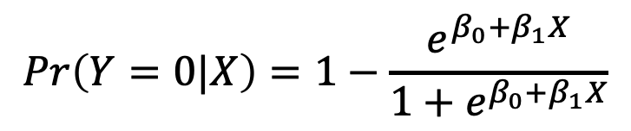
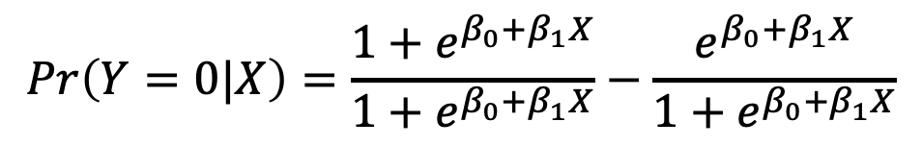
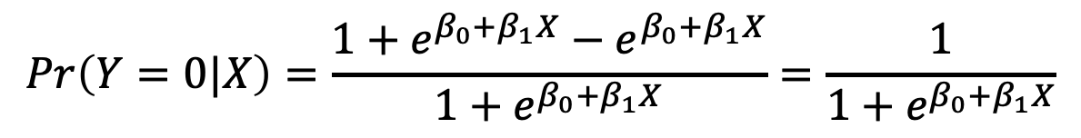
How Do We Find P(Y=0)? Recall Complement Trick
Probability the Event Happens
Probability the Event Does not Happen! Complement Trick

Slide 14
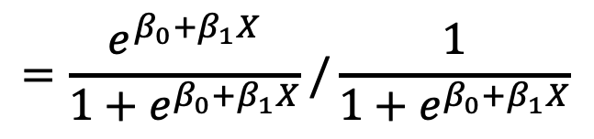
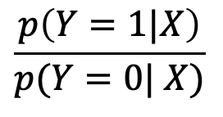
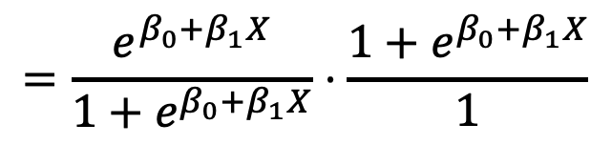
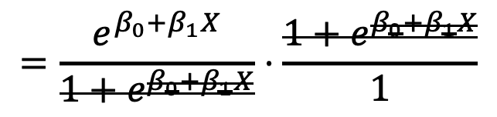
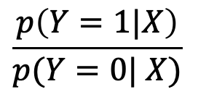

Expressing Ratio of Probabilities: Odds Ratio
We now have expressions for P(Y=1) and P(Y=0) events
Some algebra (division is equal to multiplication of the reciprocal
Next we can cross out 1 + e^
What this equation shows is that if we exponentiate the coefficients we can interpret the coefficient as the impact of the x variable on the odds ratio directly!
Odds ratio
Exponential of our coefficients

Slide 15

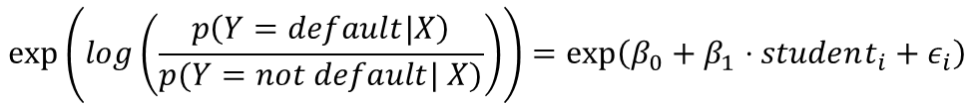

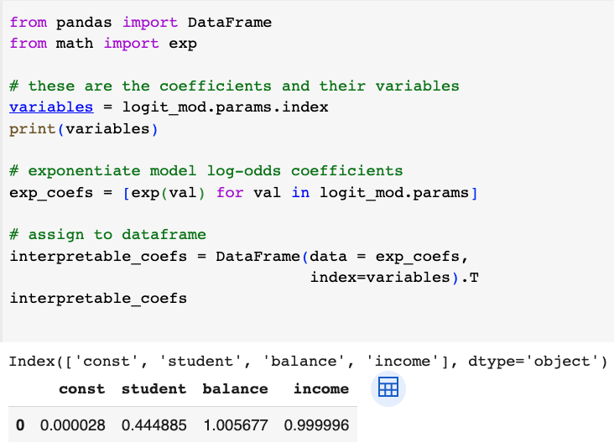
Example logistic regression interpretation
Remember the outcome variable in a logistic regression is the log odds ratio
If we exponentiate the coefficients tells us the odds ratio
If we take our estimated logistic model we see that student (beta_1) = 0.444885
This means that students have a 0.444885 lower log odd of defaulting.
Exponentiating the coefficients returns the impact of the X-variable on the odds ratio directly.
Therefore the ratio of odds of default for student vs non-student is 0.44, or students have a 55.6% lower probability of default

